Slide 1
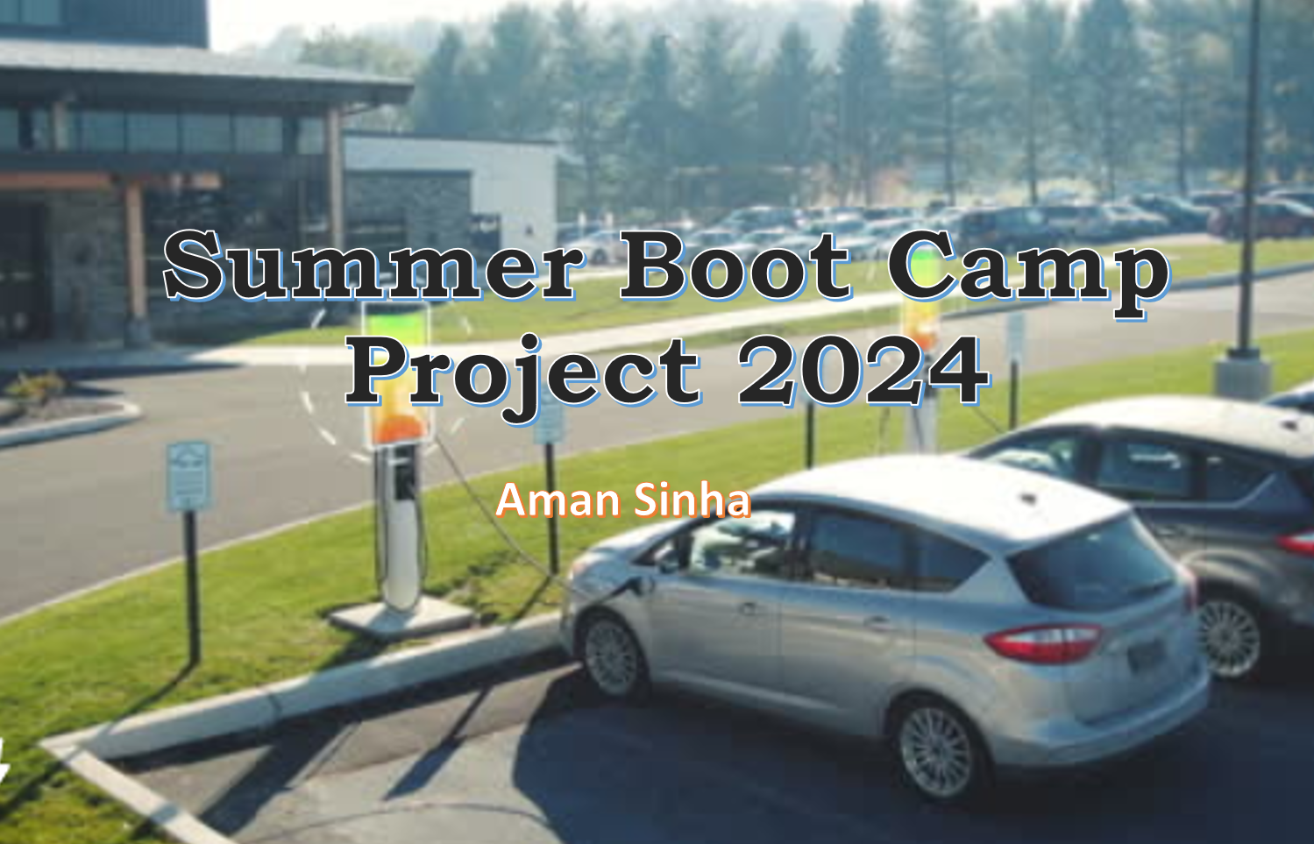
Internship Report PPT
Name: Aman Sinha
Sys id: 2022534811
Roll no: 2201010078
Subject: Summer Internship II
Subject Code: CSP 398

Slide 2
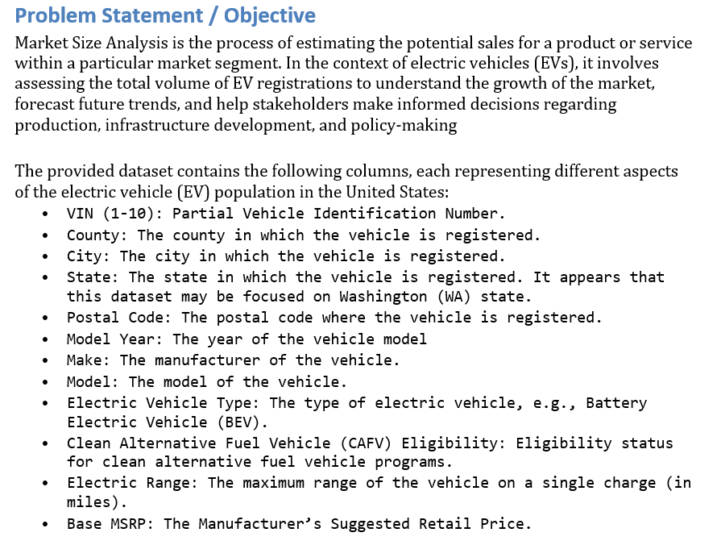
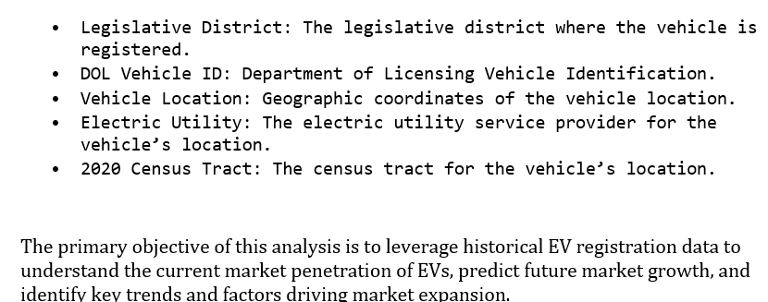

Slide 3
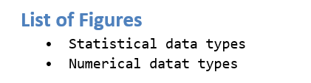
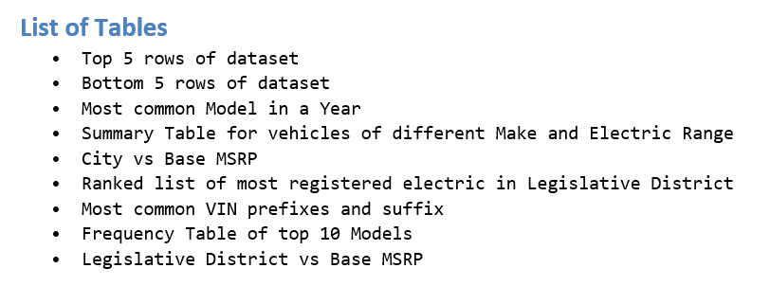

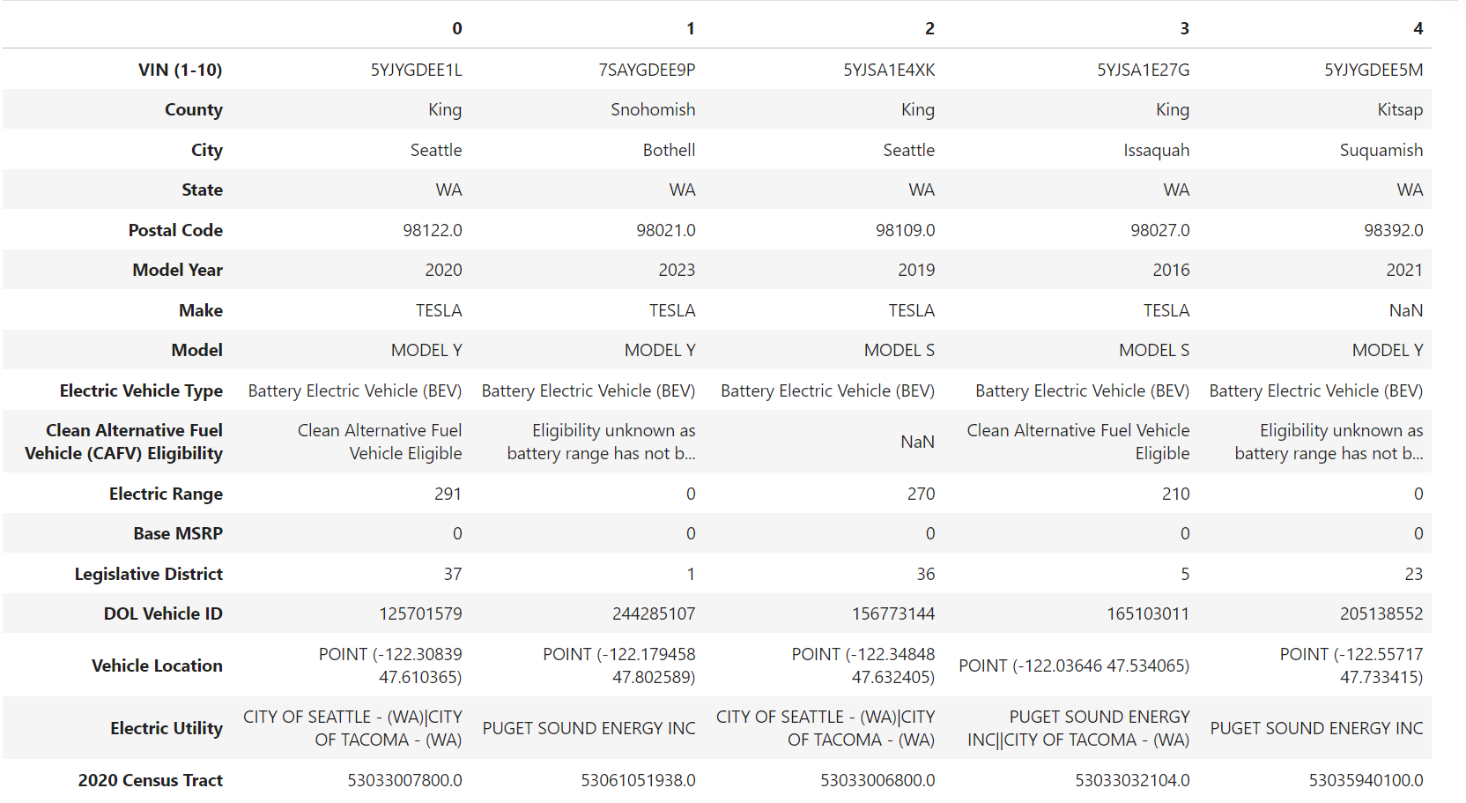
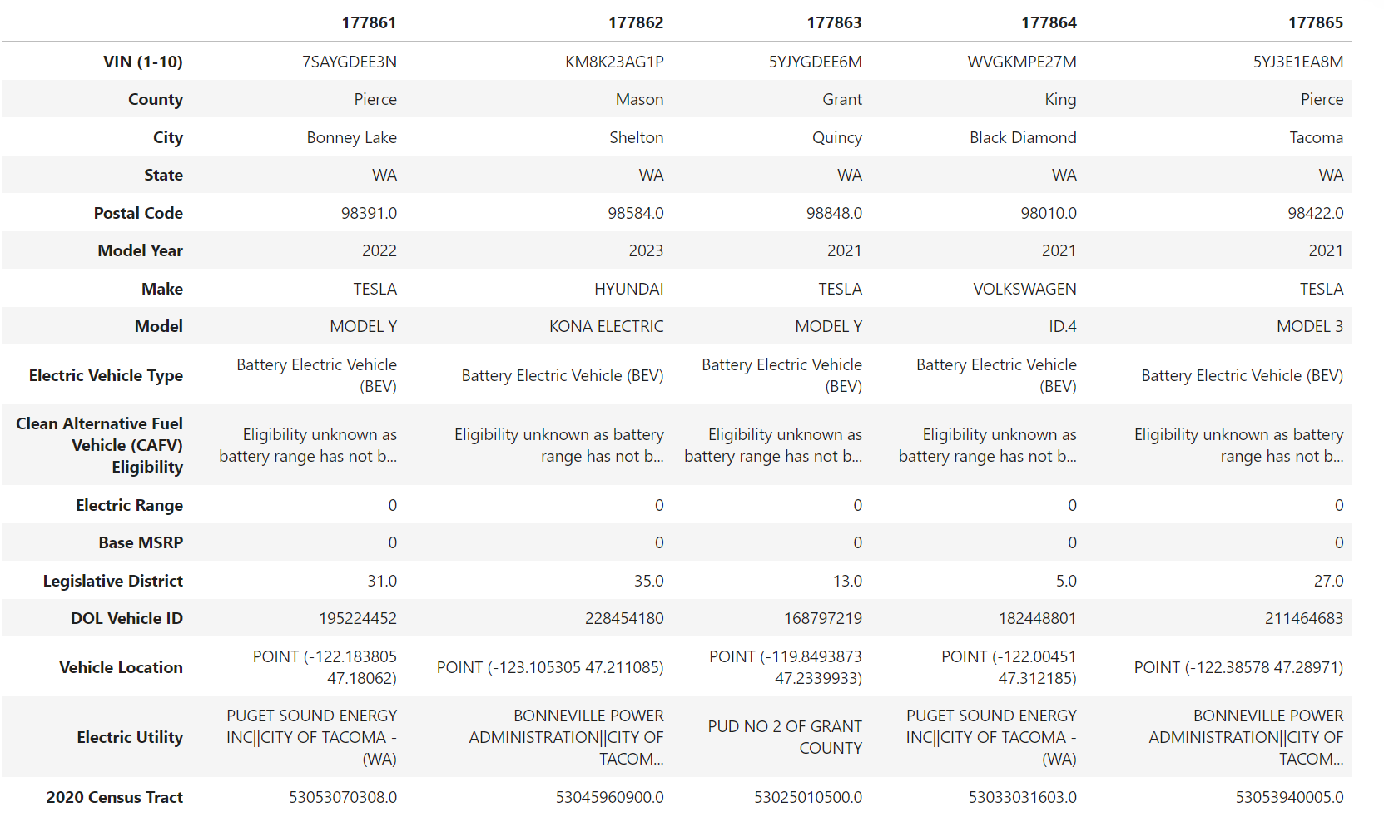

Project Overview

Slide 4
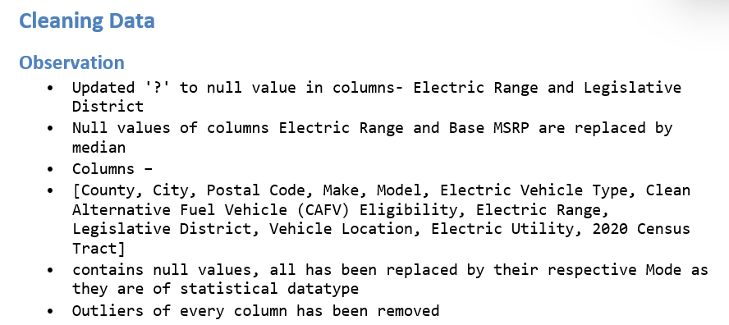

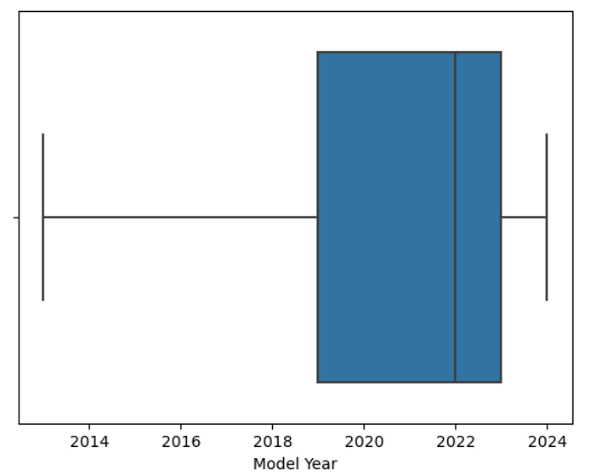
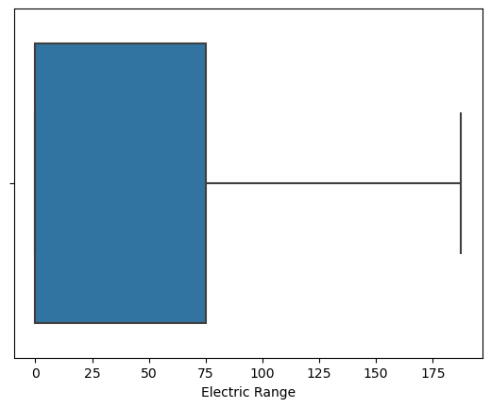
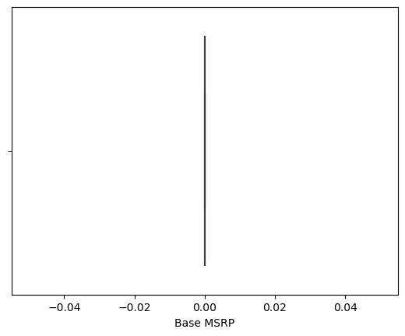
Skills Developed
After removing anomalies and converting datatypes of each column with wrong entries, the outliers representation through box plot are

Slide 5



Key Responsibilities
Graphical Representation
Represent dataset with graphs to make it readable for non-technical persons to understand.
Analysing Dataset
Clear anomalies and wrong entries
To find crucial information from the given dataset to comment on the EV’s at Washington, USA.
Clear anomalies and replace unnecessary or wrong data with the statistical data

Slide 6

Challenges Faced
Large dataset to tally
A very large dataset proved to be a small hurdle when retallying the data.
Redundant data
Redundant data in a single column made it difficult to find proper statistical data to assume further comments.
Managing time effectively
To make the code efficient multiple libraries were used having similar syntax but different parameters.

Slide 7
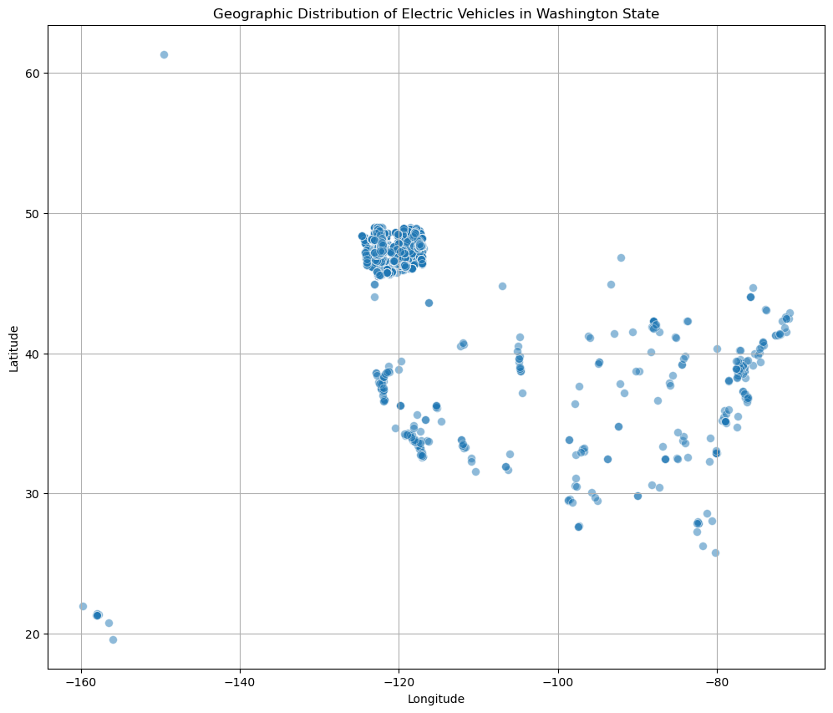
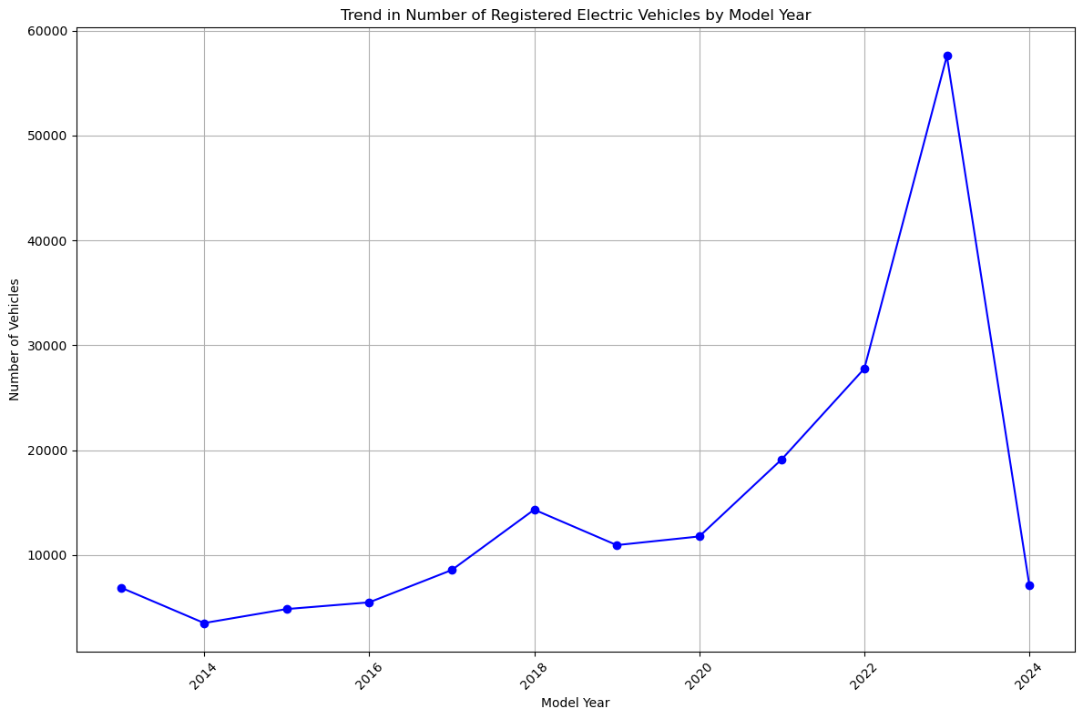
Impact and Observations
Observation based on Location & Growth
At longitude 49 and Longitude -120 the distribution is maximum
The was a steady growth in between year 2014 and 2020
2020 to 2023 saw a skyrocketing growth in the number of vehicle registered
After mid of 2023 there was a drastic fall in number of registrations in 2024

Slide 8

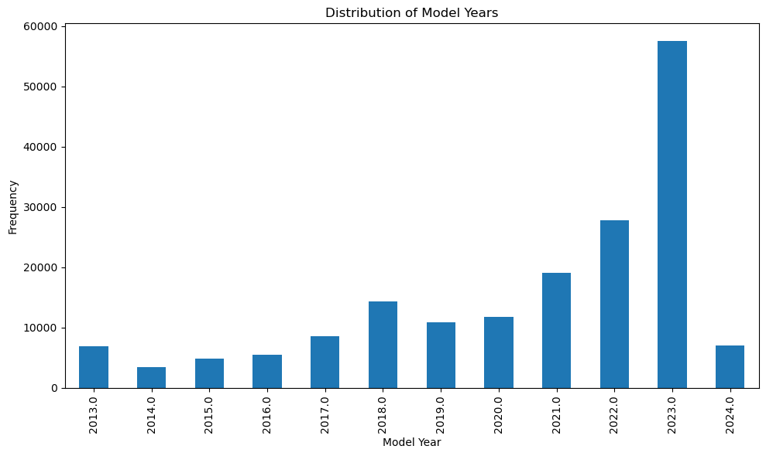
Learnings
Percentage of vehicles eligible for CAFV: 37.29%
The Base MSRP remains the same for every Legislative District
There seems to be no connection between Legislative District and Base MSRP

Slide 9

Thank you! Aman Sinha CSE 5B 202254811

